Slide 1
Social Media vs Stress
December
2025
Noelani Ching: Project 4

Slide 2
Research Purpose
1
2
3
Company Name
Q1 / Month
Year
Social media vs stress
Social media use has increased over the past decade
Stress and anxiety levels have also risen
Goal: Use real-world behavior (search trends) to explore possible connections

Slide 3
Data source & tools: via pytrends
Company Name
Q1 / Month
Year
Time period: 2015-2025
Tools used:
Two search terms:
“Social media use”
“Stress symptoms”
Python
Pandas
Matplotlib
Scikit-learn

Slide 4
How have social media and stress search levels changed over time?
Are social media and stress searches correlated?
Do the two variables show seasonal patterns?
(Linear regression prediction)
Noelani
December
2025
3 Main Research Questions

Slide 5
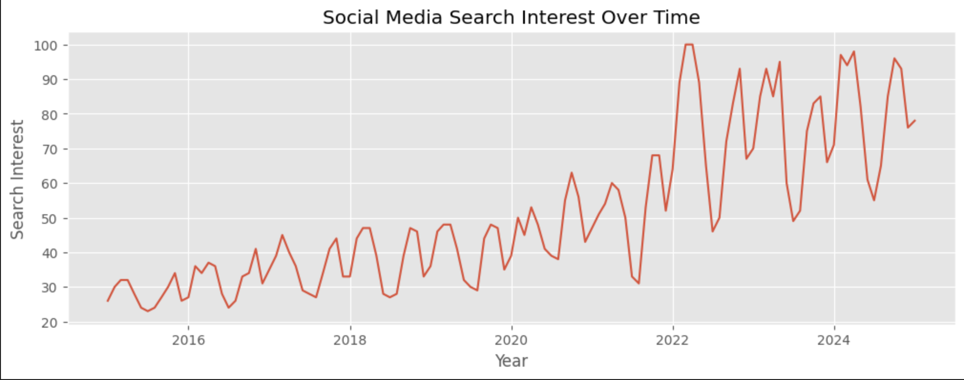
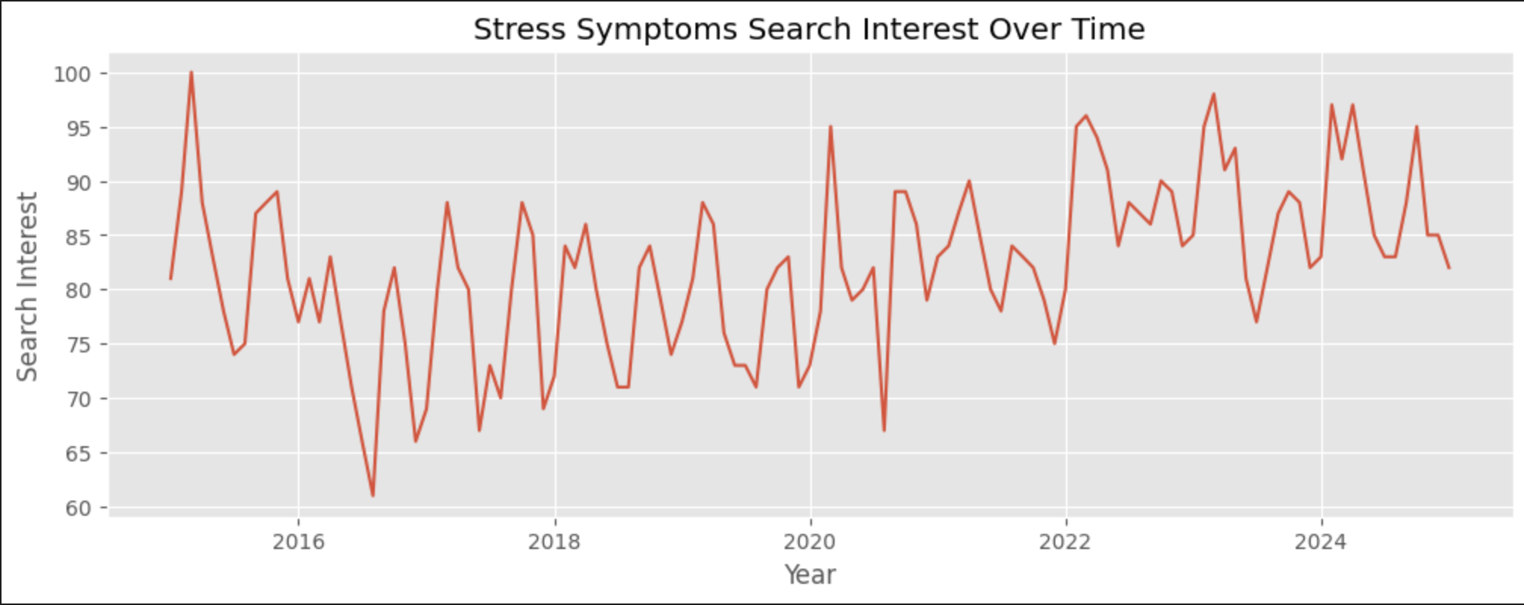
Time-Series Results
Line Chart of both trends: rolling averages
Company Name
Q1 / Month
Year
Both variables increased during the 10-year period
Stress shows large spikes
Social media use increases steadily

Slide 6
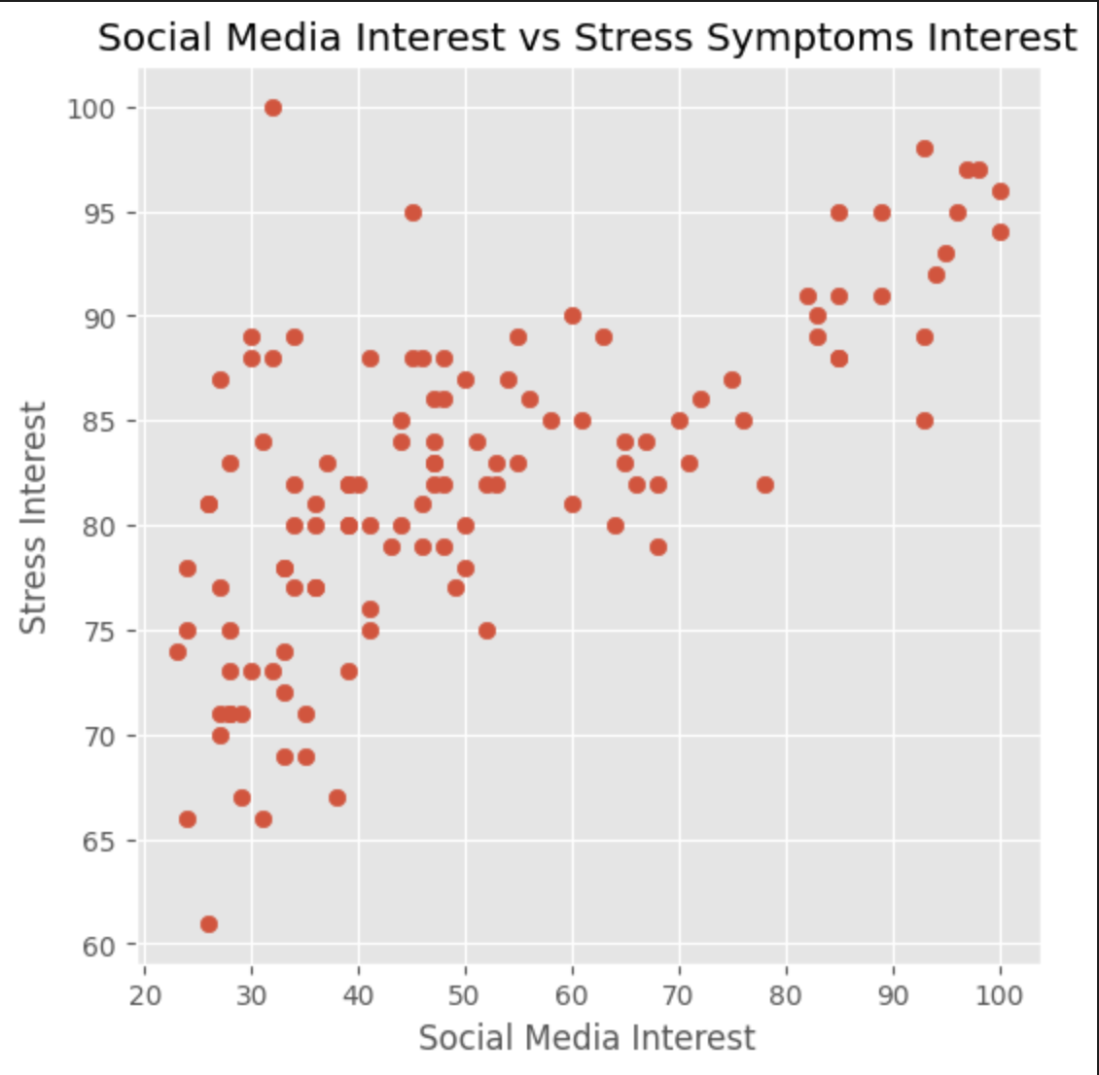
Correlation Analysis
Are the Two Variables Related?
Company Name
Q1 / Month
Year
Moderate Positive correlation
Higher social-media search interest often coincides with higher stress searches

Slide 7
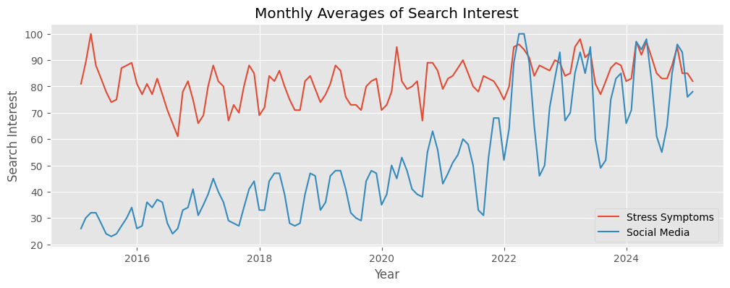
Seasonal Patterns
Seasonal Trends in Search Behavior
Company Name
Q1 / Month
Year
Stress peaks in winter (holidays, finals, seasonal depression)
Social media peaks in summer (more free time)
Both show predictable cycles

Slide 8
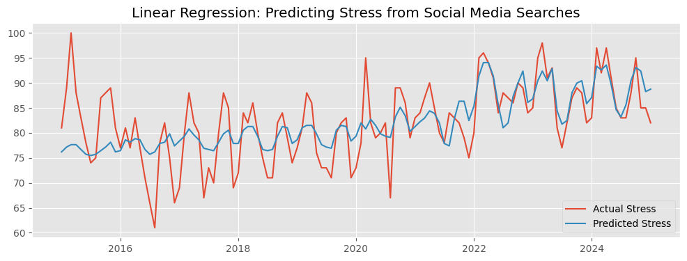
Regression Prediction
Company Name
Q1 / Month
Year
Social media vs stress
Social media interest helps predict general stress trends
Prediction accuracy is limited
Stress depends on many additional factors

Slide 9
Psychological Interpretation
Company Name
Q1 / Month
Year
Connecting Data to Psychology
Social Comparison Theory: seeing others online increases stress
Cognitive Load Theory: constant information can overwhelm the brain
Emotional Contagion: negative content spreads stress

Slide 10
Conclusion
Company Name
Q1 / Month
Year
Seasonal trends reveal predictable stress cycles
Data analytics is useful for studying real-world psychological behavior
Both variables increased over 10 years
They show a moderate relationship

Slide 11
Thank you! :)

